Slide 1
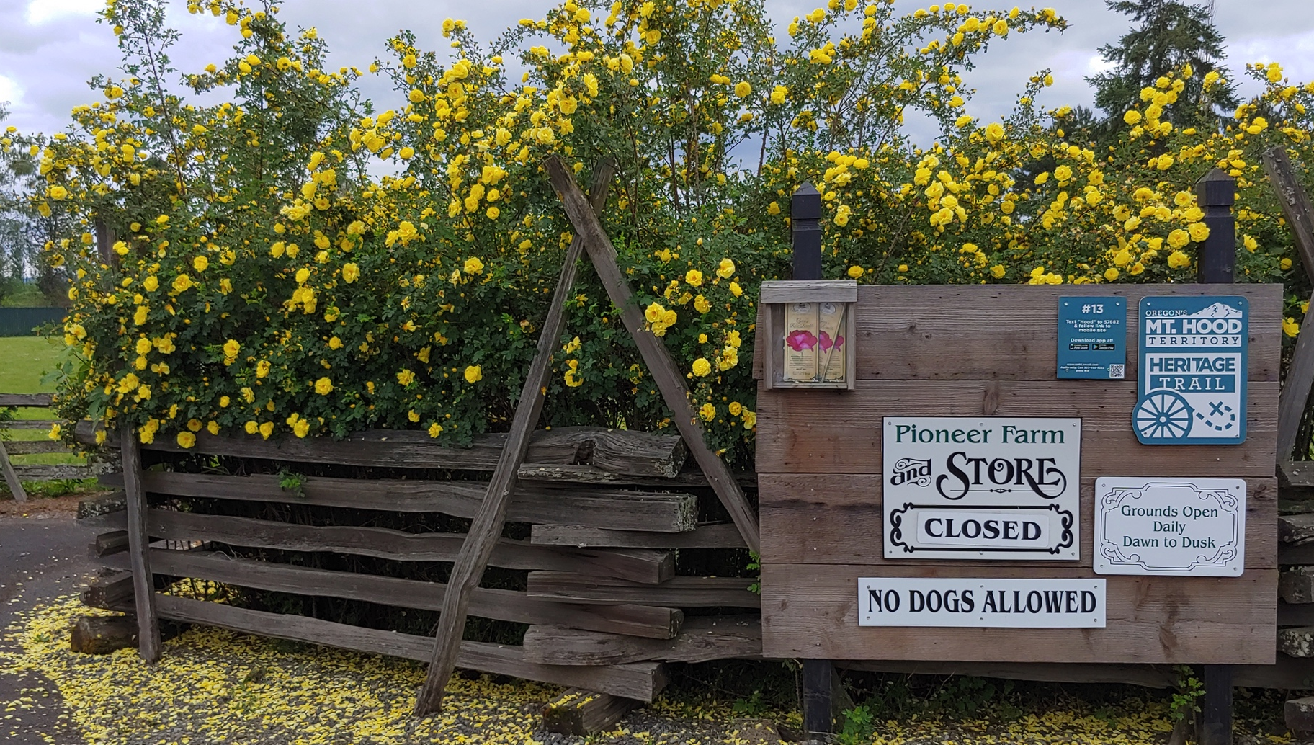
Philip Foster Farm virtual field trip
A Pioneer Life Tour
Notes:
Covid-19 version of our Pioneer Life Tour.

Slide 2
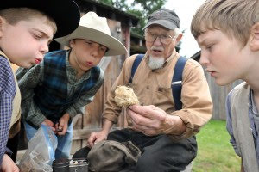
Kids love this place
Notes:
Children come with their families, with their teachers, and with their friends for field trips, tours, and day camps. We with you could come, but if you can’t, here are a few pictures to help you understand this special place in Oregon’s history.

Slide 3
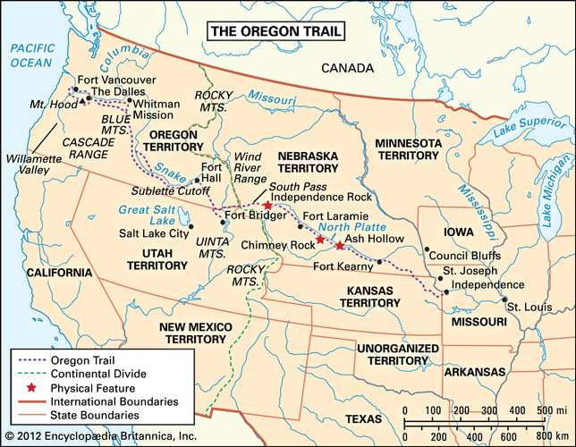
Orientation
Take a look at this map. It shows the Oregon Trail from Missouri all the way to Oregon City.
This was a 6 month journey by wagon, with no conveniences. No electricity. No running water. No toilet paper.
Notes:
How many months have you been separated from your friends? What if you couldn’t talk to them by phone, or zoom, or email, or even mail? What if you couldn’t send them pictures?
This is a choice made by families for the rest of their lives, not just for a few months on the journey.

Slide 4
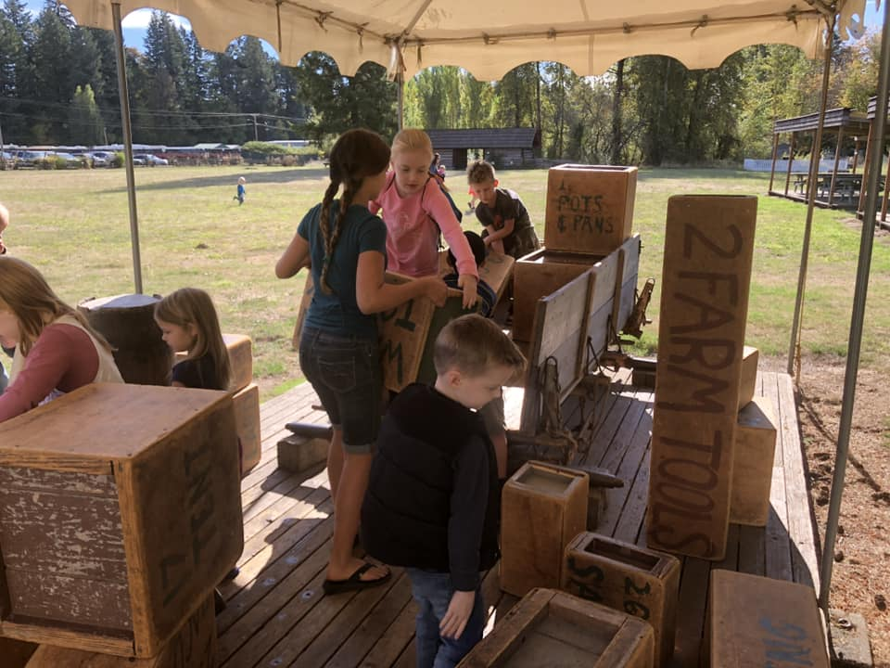
Wagon Packing
    Once your father decides to go to Oregon, he will need to decide what to take with you.
    Discuss: What supplies would you want for your trip, and what would you need in Oregon to start your farm there?
    What might you leave behind that you would really like to take? Why would you leave it behind?
Notes:
Discuss consequences of taking or not taking various items. Prioritize survival on the trip, then survival on your farm, then pleasures and memories.

Slide 5
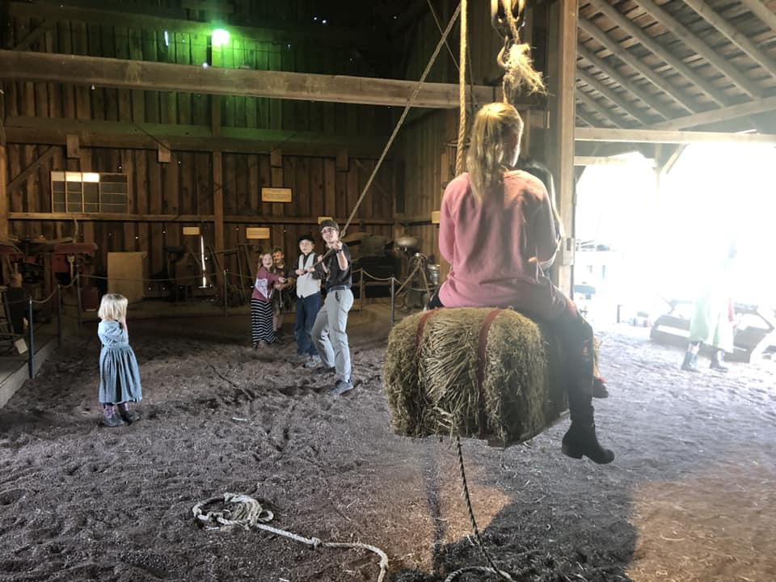
Philip Foster’s Trip
  Philip Foster didn’t come to Oregon by wagon. He was planning to start a store, so he had to bring a lot of store goods and plants with him. He came by ship.
  Like the kids pulling on these ropes, the sailors on the ship sang sea shanties to help them pull together on the ropes, moving the sails of the ship to steer it to its destination.
Notes:
The hay bale is a favorite part of our tour, where kids can ride on the bale, pulled up by their friends.

Slide 6

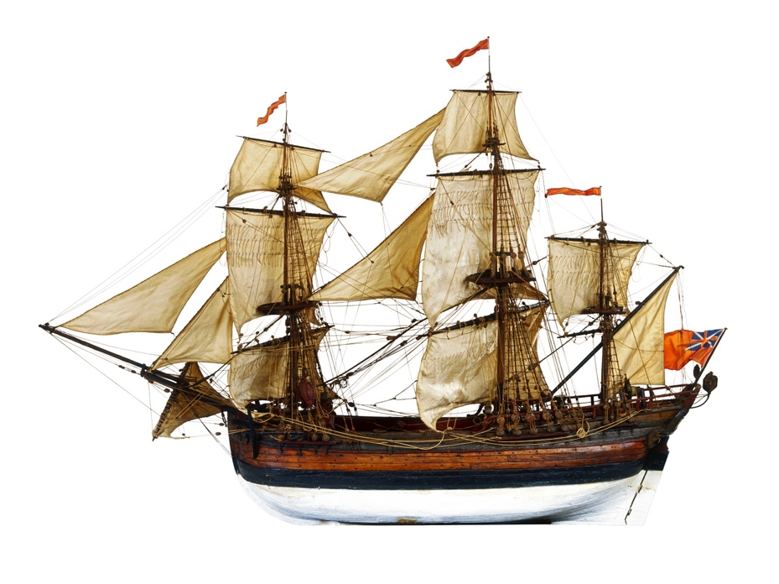
A Sea shanty
  A hundred years is a very long time
  Ho, yes, Ho
  A hundred years is a very long time
  A hundred years ago
  They used to think that pigs could fly
  Ho, yes, Ho
  I don’t believe it, no not I
  A hundred years ago
  They thought the moon was made of cheese
  Ho, yes, ho
  You can believe it if you please
  A hundred years ago
  They thought the stars were set alight
  Ho, yes, ho
  By some good angel every night
  A hundred years ago
Notes:
Sing along with Mrs. Butler. This is one version of a shanty that was sung by sailors in the 1800’s. Whenever you sing “Ho”, it’s time to pull on the ropes!

Slide 7
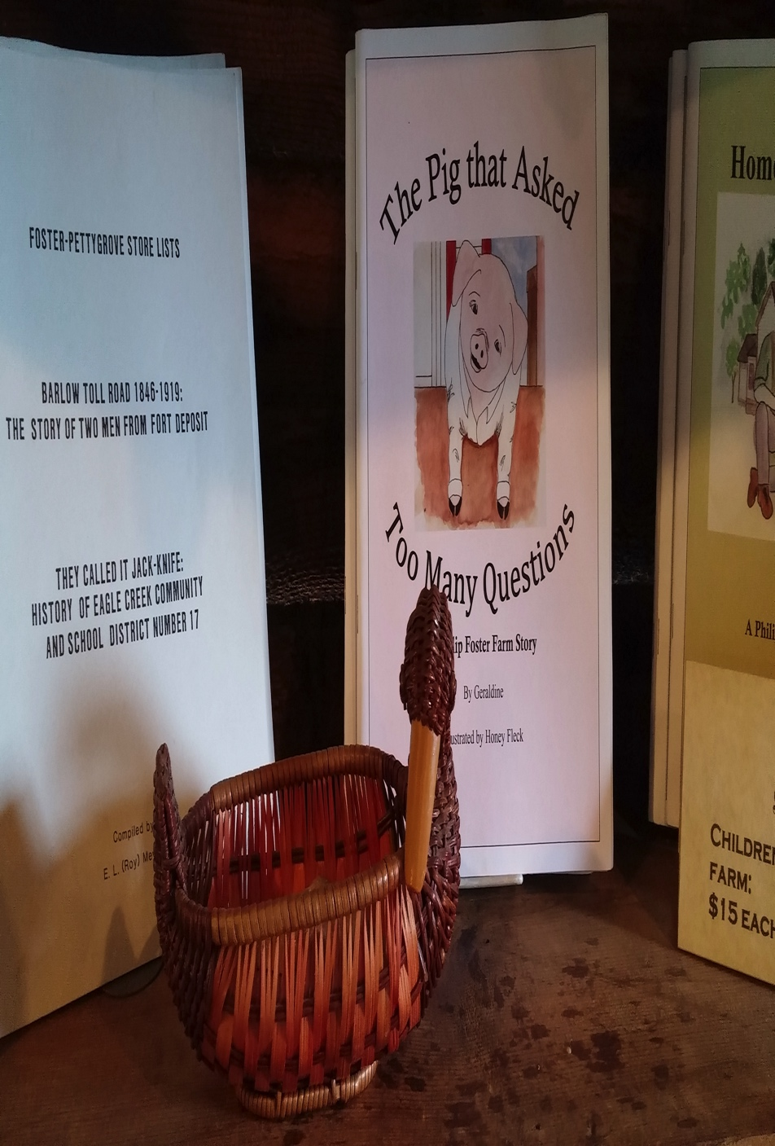
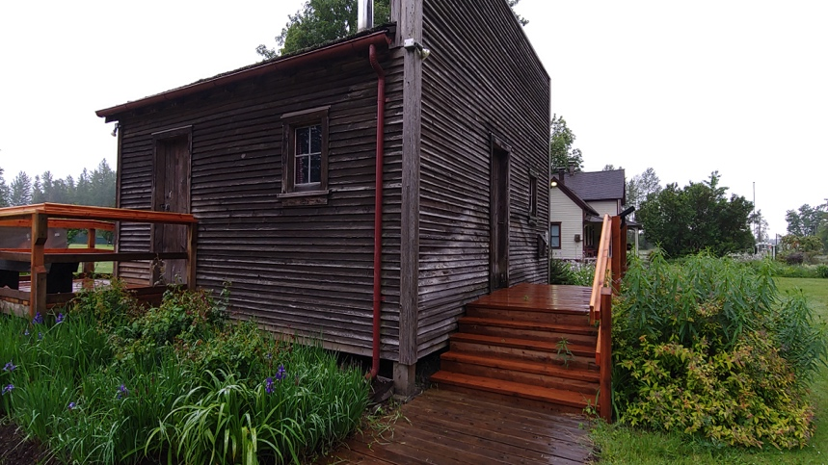
Starting a Store
Within a week after arriving in Oregon City, Philip Foster had built his store.
In pioneer times, the store was:
A place to buy and sell
Food, clothing, tools, lamps, fuel, cloth, thread, seeds, plants, labor, candy, lumber, and more!
Notes:
The store he built in Oregon City had three floors – one for his family, one for his brother-in-law’s family, and the bottom floor for customers. When he moved out to Eagle Creek, he built a store that looked like this. We know it looked like this because some of his young neighbors remembered it, and one of them had become an architect. He drew us a blueprint so we would know exactly how to build this replica. Notice that it had a “store front” that was bigger than the actual store. He didn’t even need to put a sign on it because everyone knew that square front meant it was a store.

Slide 8
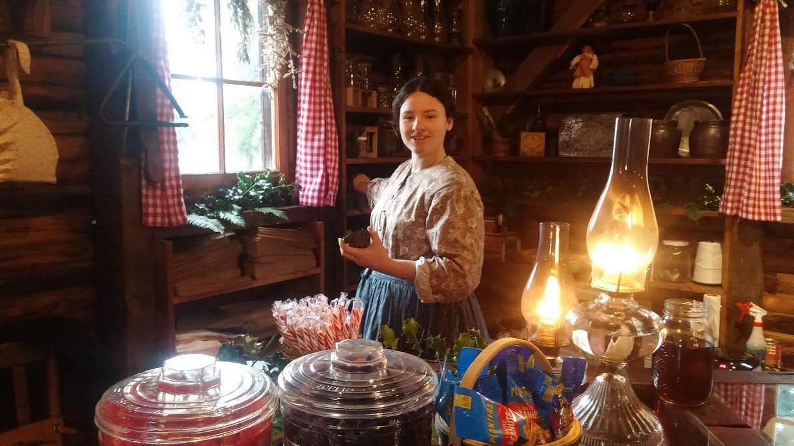
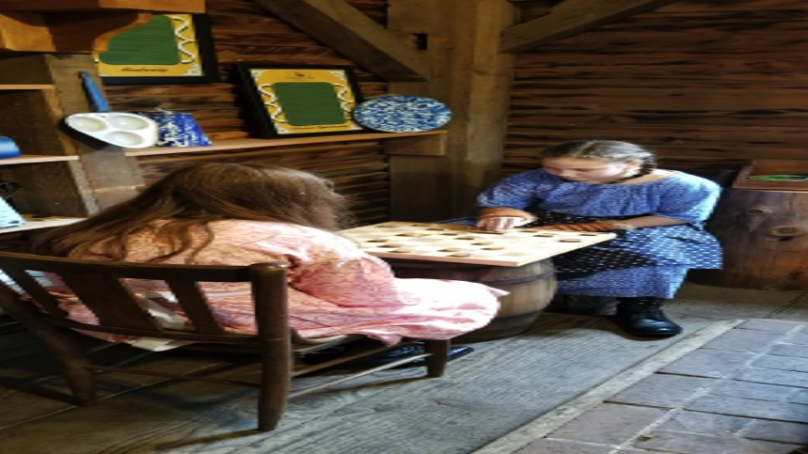
What can you do here?
In pioneer times, the store was also:
A place to pick up and send mail
A place to borrow money and pay bills
A place to visit and play games
The heart of the community

Slide 9
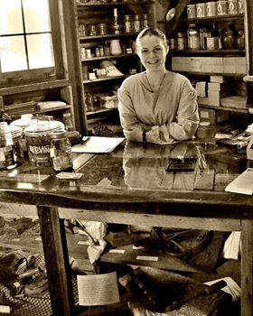
Stores
What would you do in Philip Foster’s store? What would you buy?
How would you pay for it? Would you send a letter to your friends back East?
What would you tell them?

Slide 10
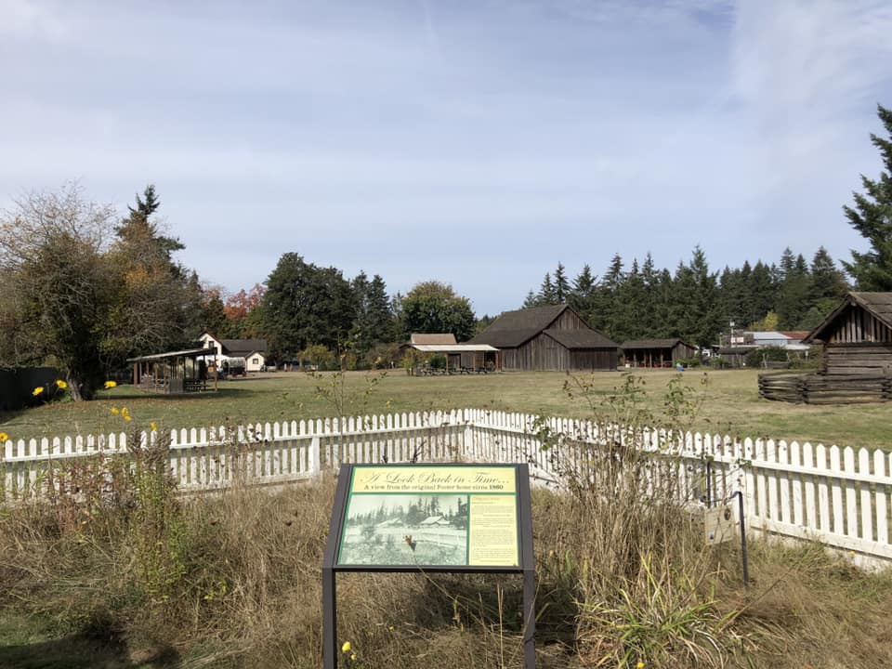
Old house site
Looking from the original home site toward the barn and store.
Notes:
The first house Foster built in Eagle Creek was here, with a picket fence around it. It probably started out as a log house, but he added milled lumber (flat boards) to it as soon as he built the lumber mill. Guests were allowed to sleep on Foster’s floor for 50 cents, but they had to provide their own bedding. He also served meals to his guests, probably made by Mrs. Foster over a wood stove.

Slide 11
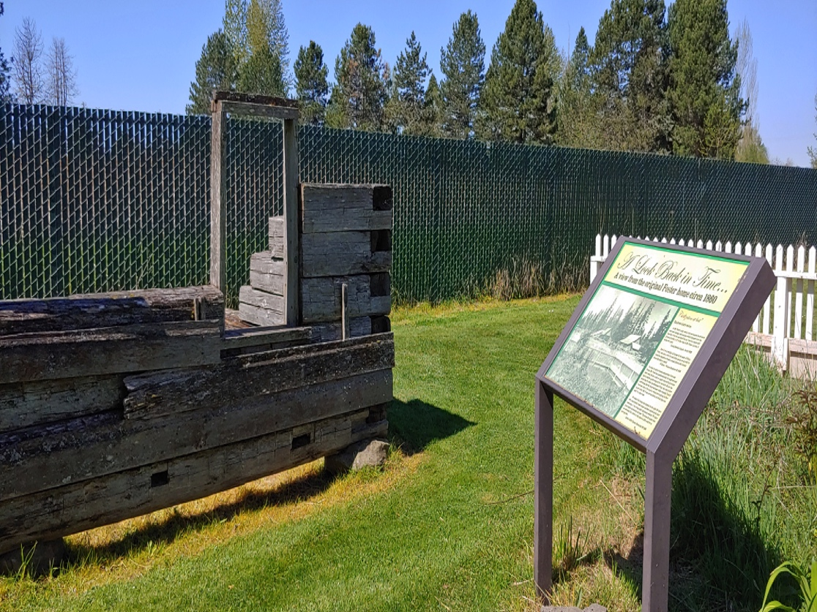
Old house site
Climbing structure shows where Foster’s original house was.
Notes:
Volunteers built this simple climbing structure to show where Foster’s house was from 1848 to 1883. In the fall, it was like a hotel, serving thousands of guests from the Barlow Road, at the end of the Oregon Trail. The rest of the year, it was just a nice big house to raise their family.

Slide 12
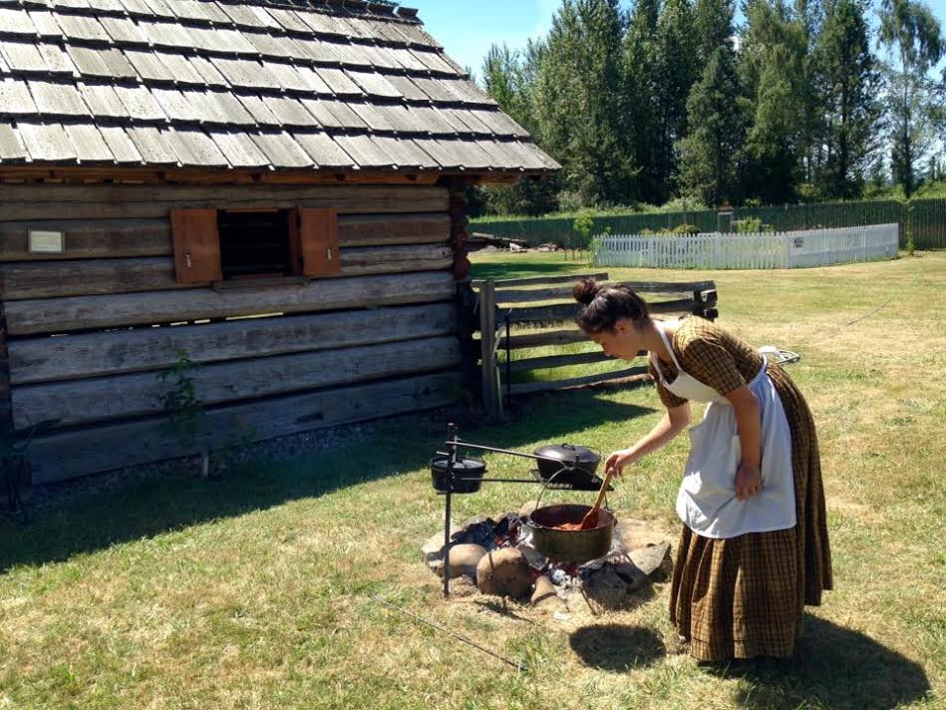
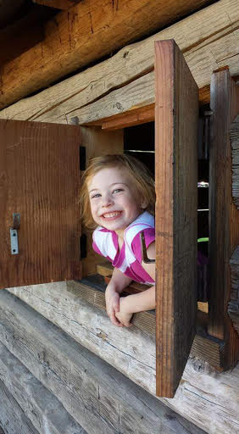
A Cabin for the night
In 1845, Sam Barlow headed out with his family on a wagon train to Oregon. Arriving at the Dalles, he decided to skip the trip down the river and instead go around Mount Hood by land and straight in to Oregon City.
Notes:
Foster’s guests could stay in this simple log cabin. One of those guests described it in her journal: “It was a dogtrot with walls without caulking, doors without hinges, windows without sashes, and fireplaces without chimneys, but that did not matter because the smoke simply blew through the holes in the walls.” This cabin was like an Air BnB – just a shortterm place to stay until you could move on and find your own place. Foster charged $2.00 to stay here for a night.

Slide 13
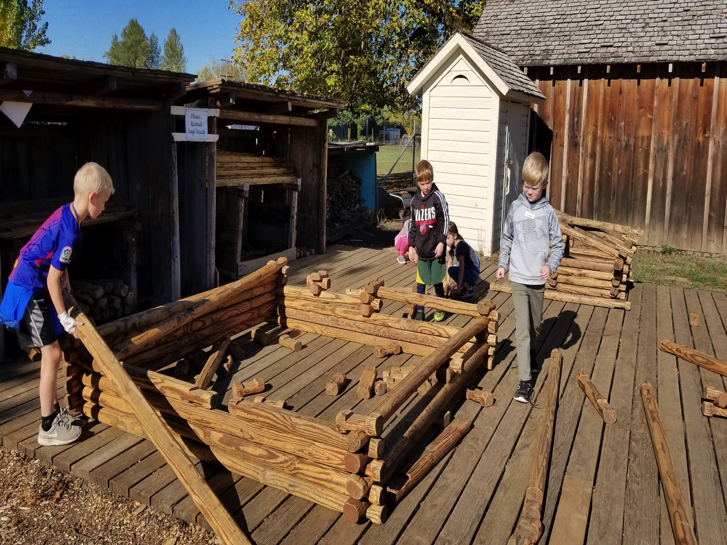
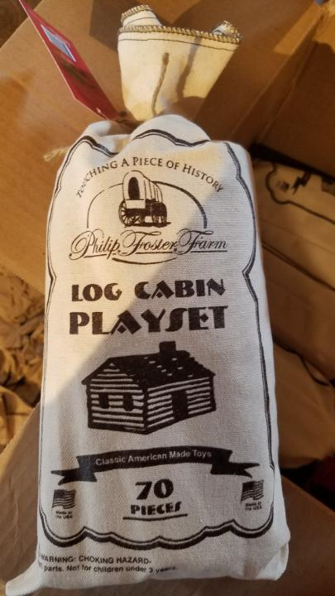
Build your own cabin
Notes:
The giant Lincoln Logs are a favorite station. The logs are made and maintained by Philip Foster’s great-great-grandson, Tom Burnett. You can also purchase smaller sets in the store.

Slide 14
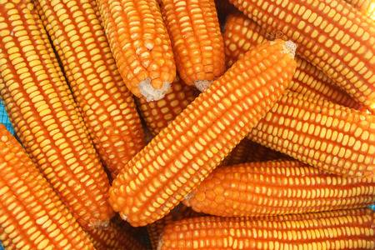
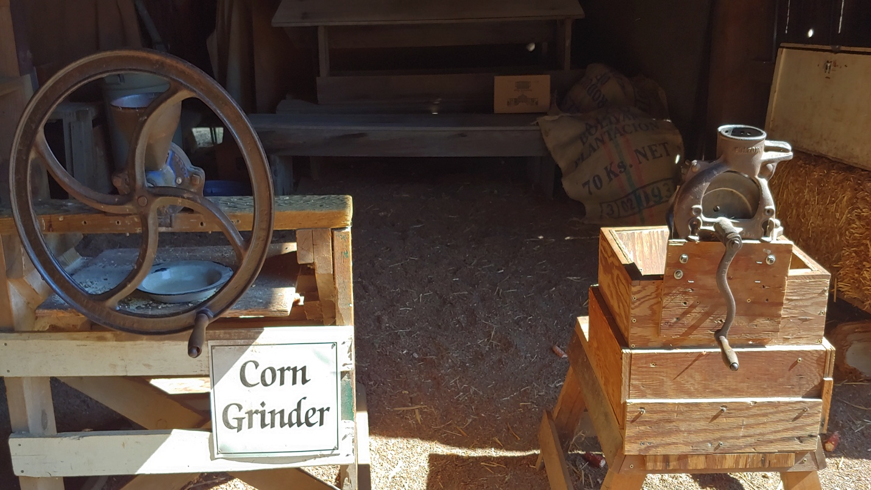
Grinding Corn
Notes:
Each ear of dried corn goes into the sheller first. Turning the handle of the sheller strips the corn off the cob. Then the loose corn is poured into the grinder, to be ground into corn meal for animal feed, corn meal mush, corn bread, and other treats.

Slide 15
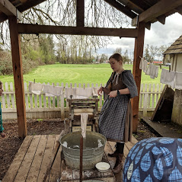
Laundry Station
Here at the Laundry Station, guests can agitate, scrub, rinse, wring out their laundry, and then hang it up to dry.
Notes:
For a video of the laundry station in action, visit YouTube and search for Philip Foster Farm. Many people have posted videos there of the Farm in action.

Slide 16
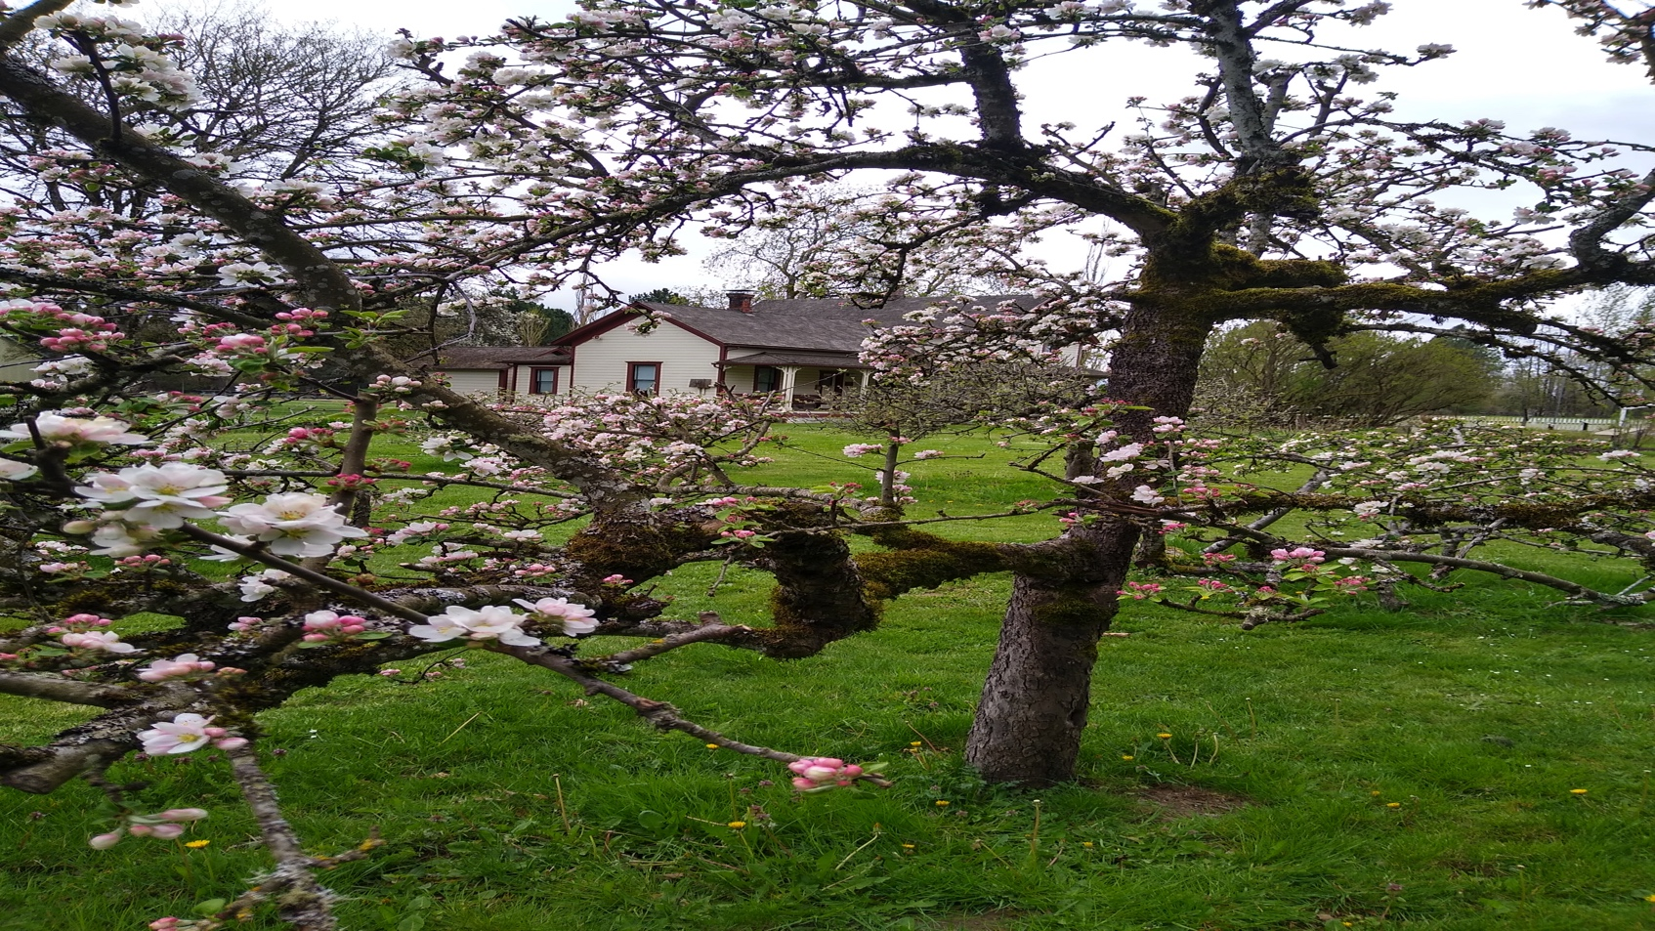
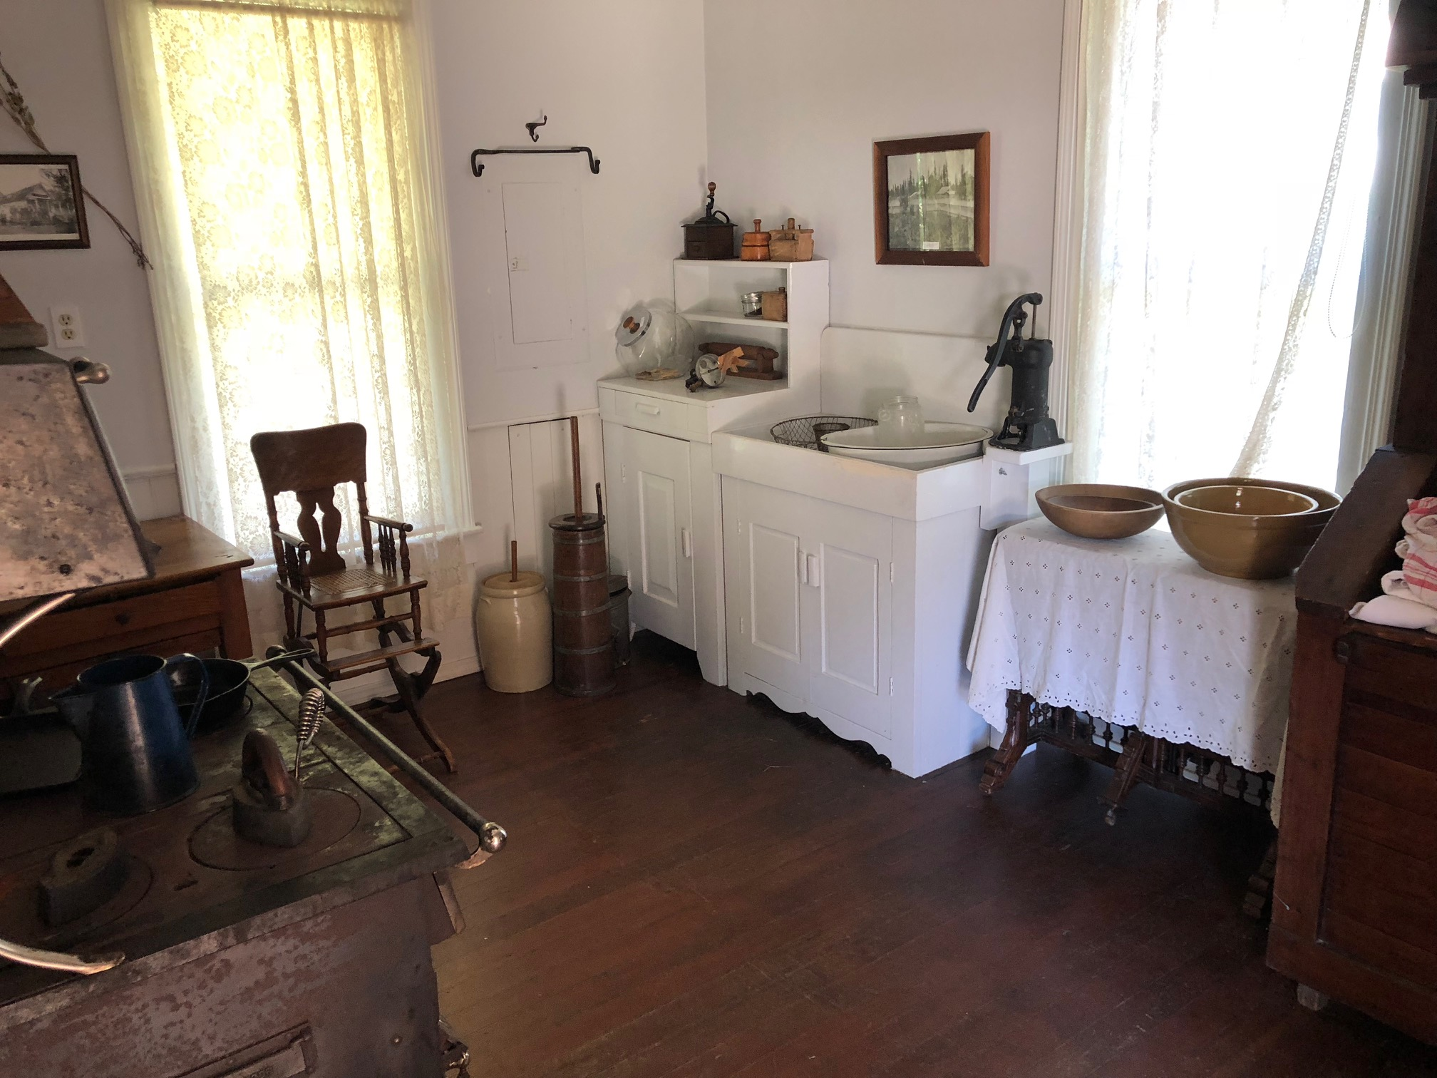
Egbert’s Kitchen
Notes:
Egbert was Philip’s youngest son. This house was built for him in 1883, after most of the wagons had stopped arriving in Eagle Creek. Here you can see his kitchen, with a wood stove, a “dry sink”, and butter churns. The dry sink had a pipe down into a barrel under the house, which had to be filled each day, but there was no drain to empty the sink, so water was saved in a basin and dumped outside. Egbert liked to sit in the kitchen to entertain his guests.

Slide 17
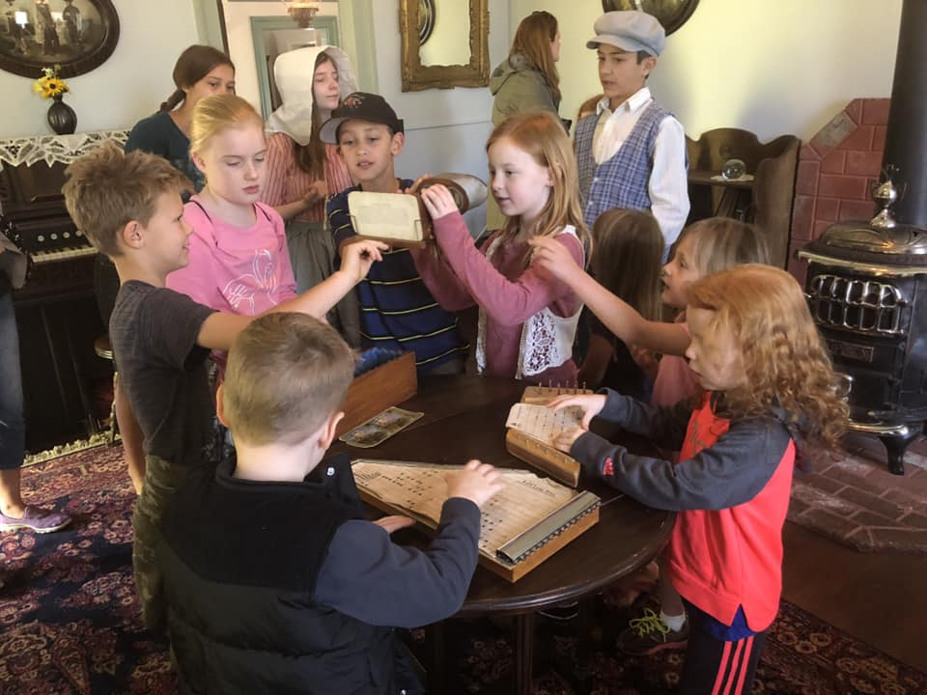
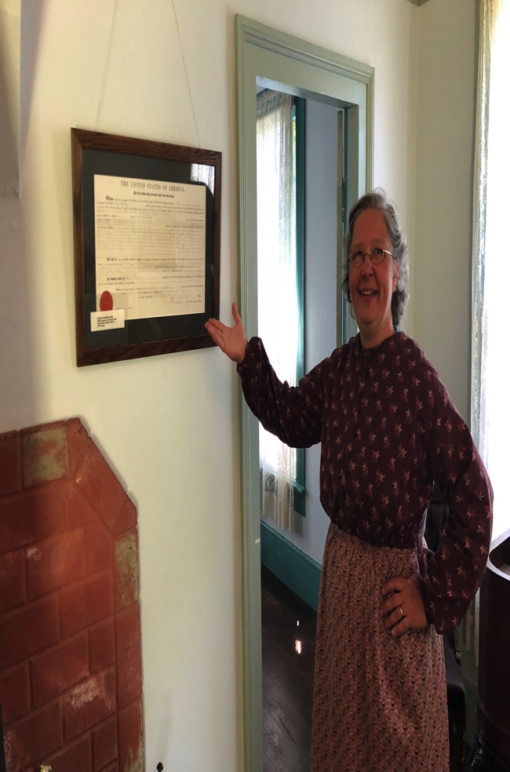
Egbert’s Parlor
Notes:
Here in Egbert’s parlor we have the original land grant, which gave Philip half and Mary Charlotte half of the 642 acres given them by the federal government. The grant is signed by Ulysses S. Grant, who was the President of the United States when Philip applied for the grant in 1877.

Slide 18
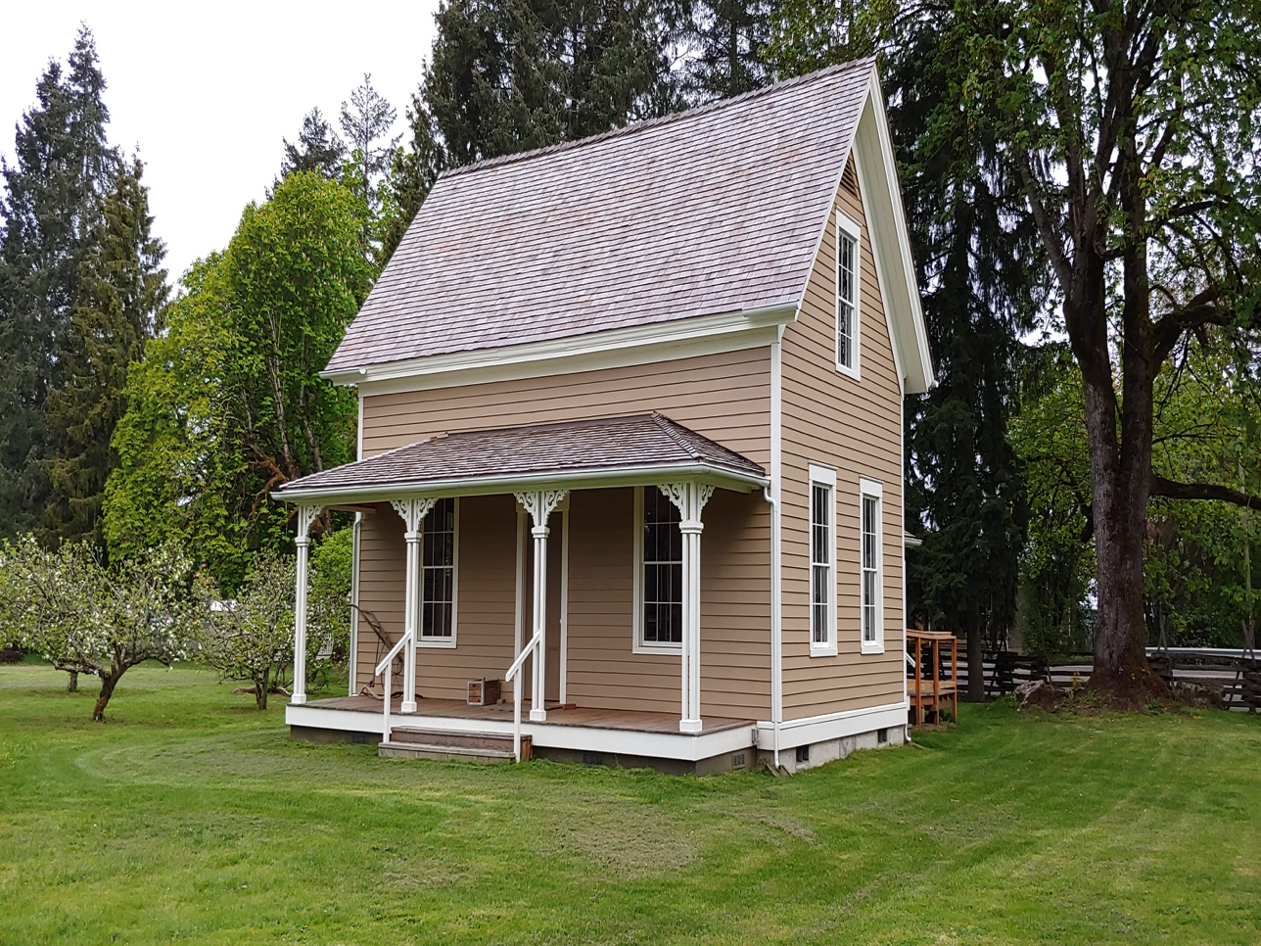
Lucy’s House
Notes:
This is the oldest building on the Farm, but also the newest! It was moved here from across the street, and has been restored to look as much like it did in 1860 as possible. Lucy was Philip’s oldest daughter and lived in this house from 1860 to 1878.

Slide 19
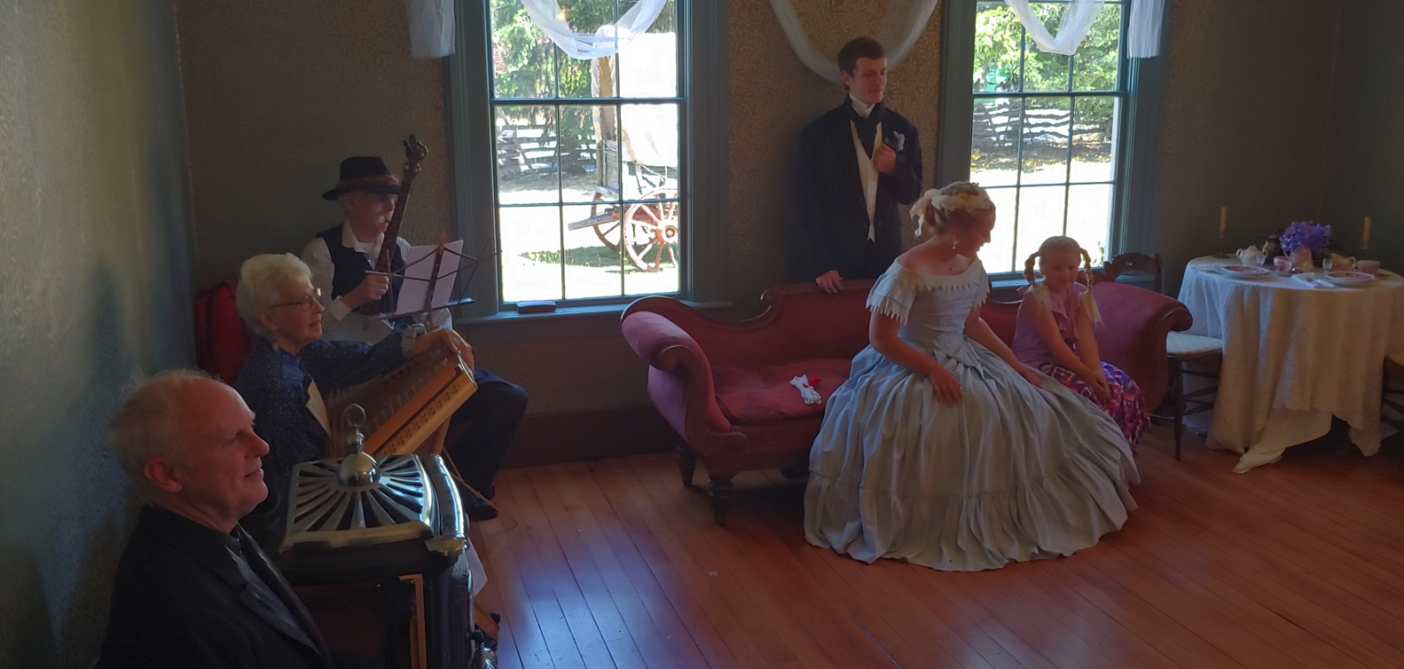
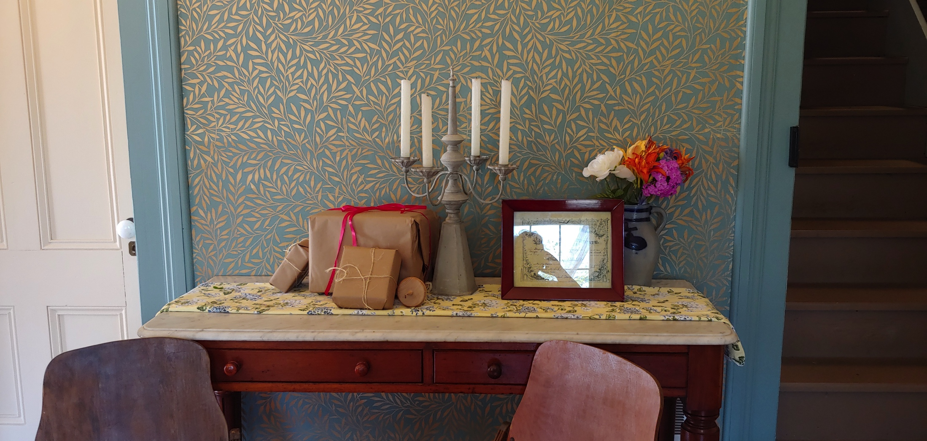
Lucy’s Parlor
Notes:
In a pioneer home the parlor was a special place for entertaining your company. Usually the front steps led right up to the parlor door for guests. Family would come in through the kitchen, and kept the parlor clean and ready for company. In the years before telephones, you never knew when a neighbor might drop by!

Slide 20
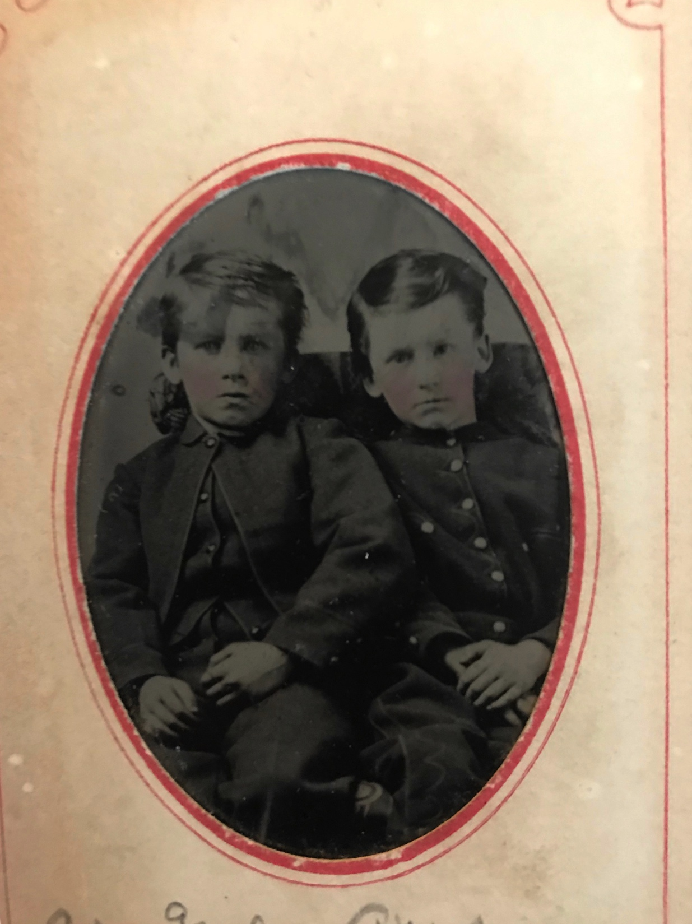
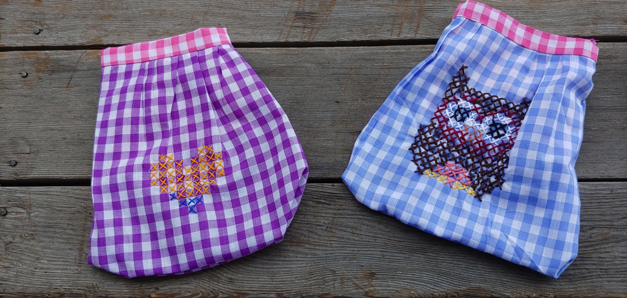
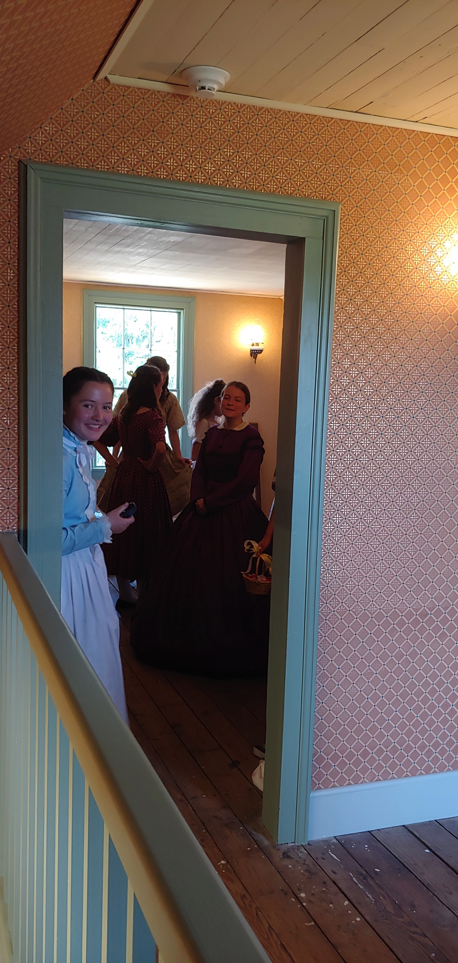
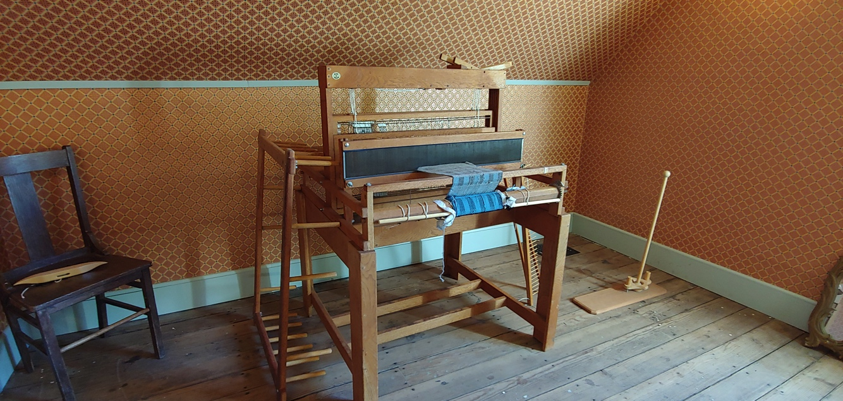
Upstairs at Lucy’s House
Notes:
The room at the top of the stairs is for weaving, sewing, and other crafts. Here is a loom, for making cloth. All 4 of Lucy’s sons probably slept in the big upstairs bedroom.

Slide 21
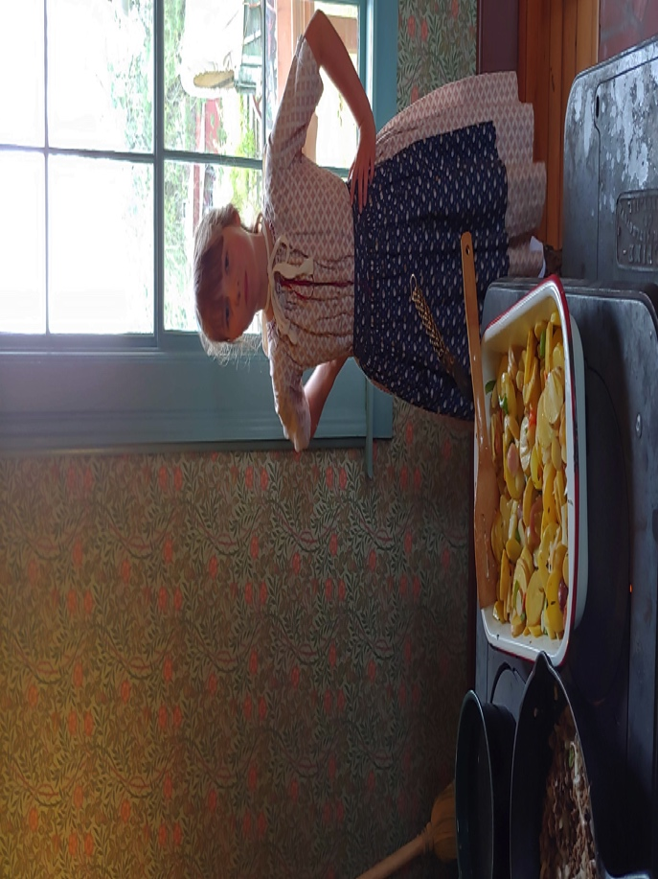
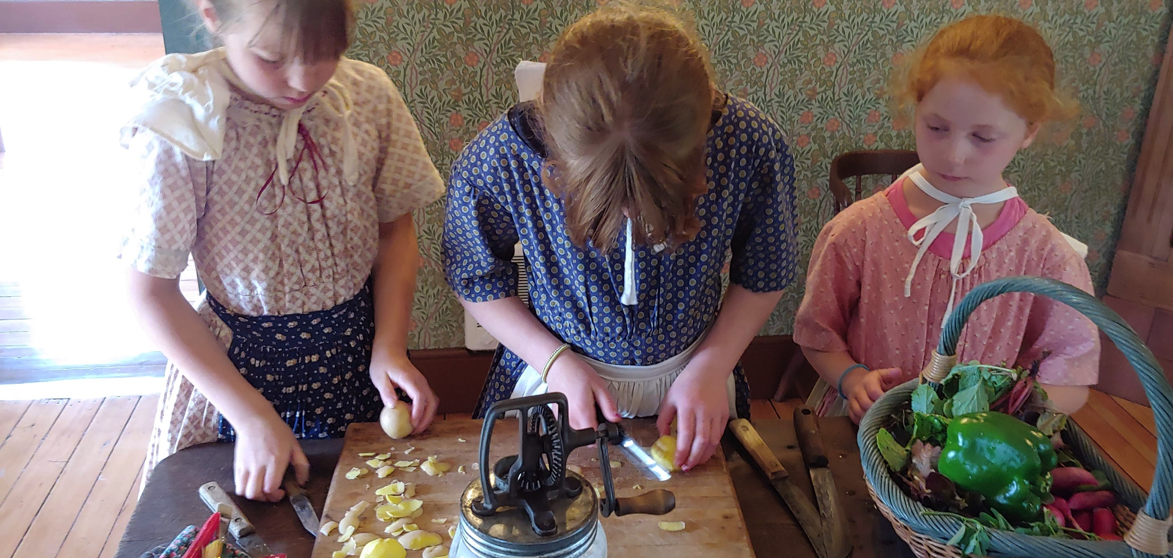
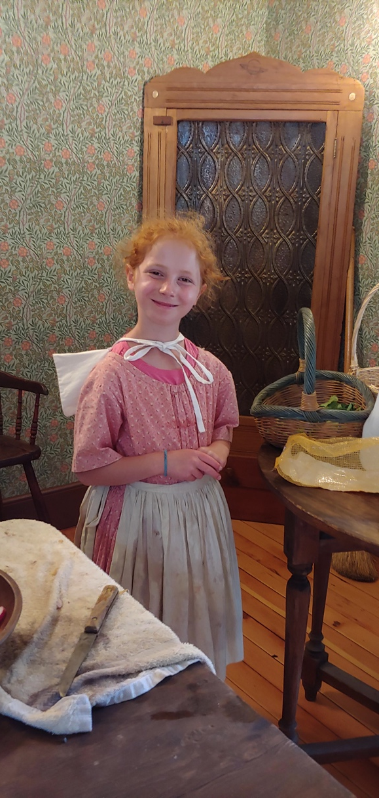
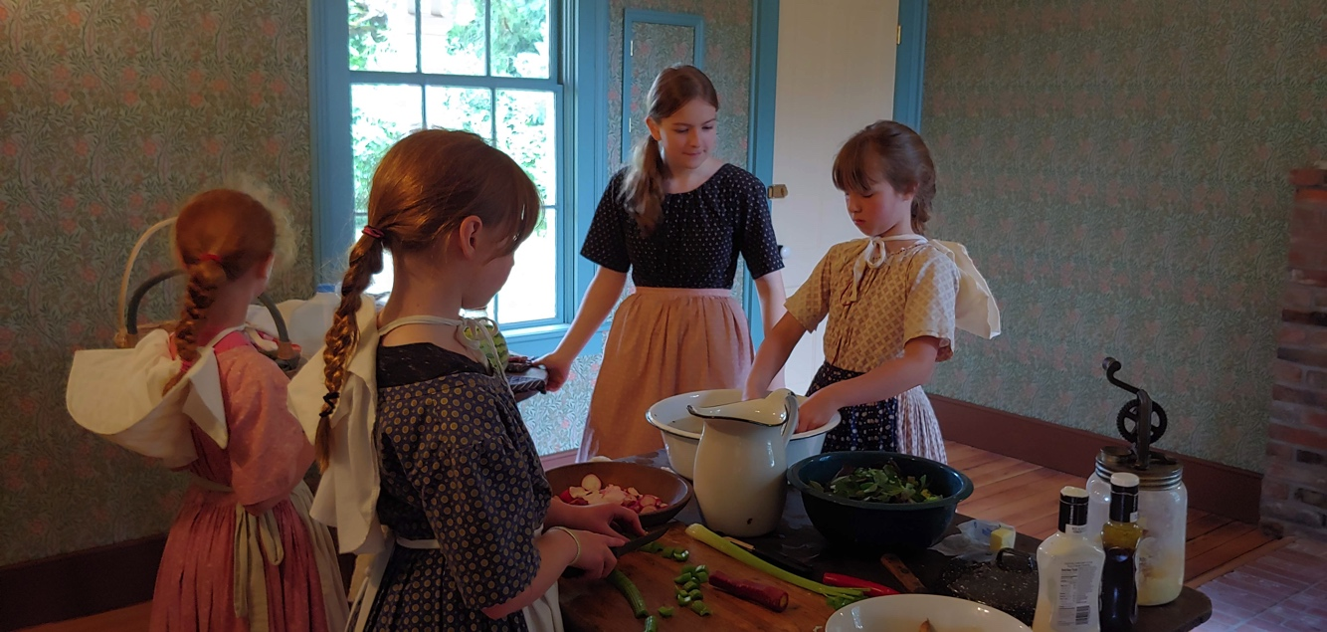
Lucy’s kitchen
Notes:
The wood stove is always hot for cooking, and there are lots of jobs for helpful children here in Lucy’s kitchen. These summer campers cooked up a delicious lunch!

Slide 22
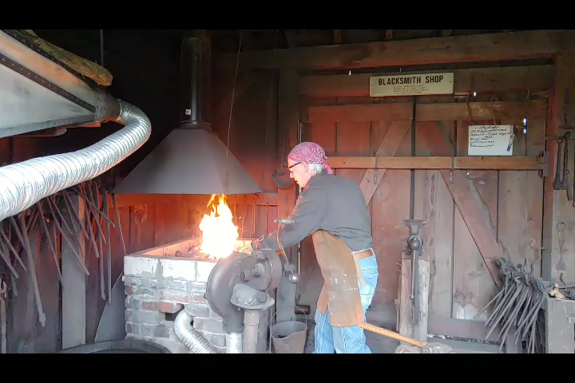
Blacksmith Shop
Notes:
Our blacksmiths make hooks, nails, and lots more. This smith, Michael Schmoker, is “hammer welding”, which requires an extra hot fire (2000 degrees) and creates a lot of sparks. Our school tours don’t usually get to see this! Experienced blacksmiths like Michael train other volunteers to work in the shop. If you are careful and attentive, you could learn to be a blacksmith, too!

Slide 23
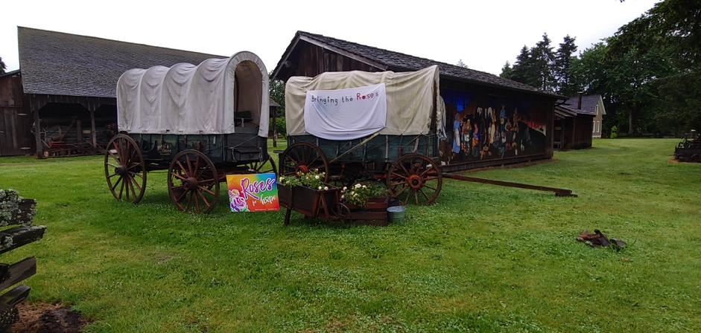
Thanks for Coming!
We will be closed this summer (2020), but the grounds are always open, and you are welcome to visit.
Watch our website at https://philipfosterfarm.com
Notes:
This spring (2020) the museum is closed, but volunteers are still working (at a safe distance). This is our entry for the Rose Festival’s “Porch parade”.

